Slide 1

Slides developed by Mine Çetinkaya-Rundel of OpenIntro
Translated from LaTeX to Google Slides by Curry W. Hilton of OpenIntro.
The slides may be copied, edited, and/or shared via the CC BY-SA license
To make a copy of these slides, go to File > Download as > [option], as shown below. Or if you are logged into a Google account, you can choose Make a copy... to create your own version in Google Drive.

Slide 2
Poisson Distribution

Slide 3
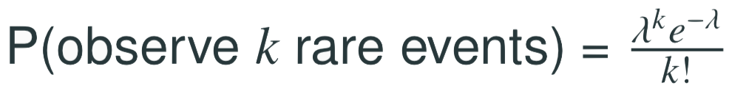
Poisson distribution
The Poisson distribution is often useful for estimating the number of rare events in a large population over a short unit of time for a fixed population if the individuals within the population are independent.
The rate for a Poisson distribution is the average number of occurrences in a mostly-fixed population per unit of time, and is typically denoted by λ.
Using the rate, we can describe the probability of observing exactly k rare events in a single unit of time.
where k may take a value 0, 1, 2, and so on, and k! represents k-factorial. The letter e ≈ 2.718 is the base of the natural logarithm.
57 The mean and standard deviation of this distribution are λ and √λ, respectively

Slide 4
Example #1
Suppose that in a rural region of a developing country electricity power failures occur following a Poisson distribution with an average of 2 failures every week. Calculate the probability that in a given week the electricity fails only once.

Slide 5
Example #1
Suppose that in a rural region of a developing country electricity power failures occur following a Poisson distribution with an average of 2 failures every week. Calculate the probability that in a given week the electricity fails only once.
Given λ = 2.

Slide 6
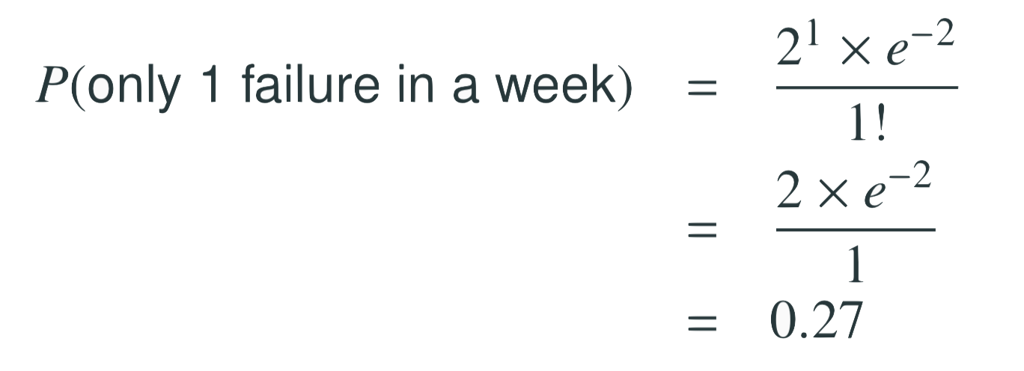
Example #1
Suppose that in a rural region of a developing country electricity power failures occur following a Poisson distribution with an average of 2 failures every week. Calculate the probability that in a given week the electricity fails only once.
Given λ = 2.

Slide 7
Example #1
Suppose that in a rural region of a developing country electricity power failures occur following a Poisson distribution with an average of 2 failures every week. Calculate the probability that in a given week the electricity fails only once.
Given λ = 2.

Slide 8
Example #1
Suppose that in a rural region of a developing country electricity power failures occur following a Poisson distribution with an average of 2 failures every week. Calculate the probability that in a given week the electricity fails only once.
Given λ = 2.

Slide 9
Example #2
Suppose that in a rural region of a developing country electricity power failures occur following a Poisson distribution with an average of 2 failures every week. Calculate the probability that on a given day the electricity fails three times.

Slide 10
Example #2
Suppose that in a rural region of a developing country electricity power failures occur following a Poisson distribution with an average of 2 failures every week. Calculate the probability that on a given day the electricity fails three times.
We are given the weekly failure rate, but to answer this question
we need to first calculate the average rate of failure on a given day:
λ_{day} = 2 = 0.2857. Note that we are assuming that the probability 7
of power failure is the same on any day of the week, i.e. we assume independence.

Slide 11
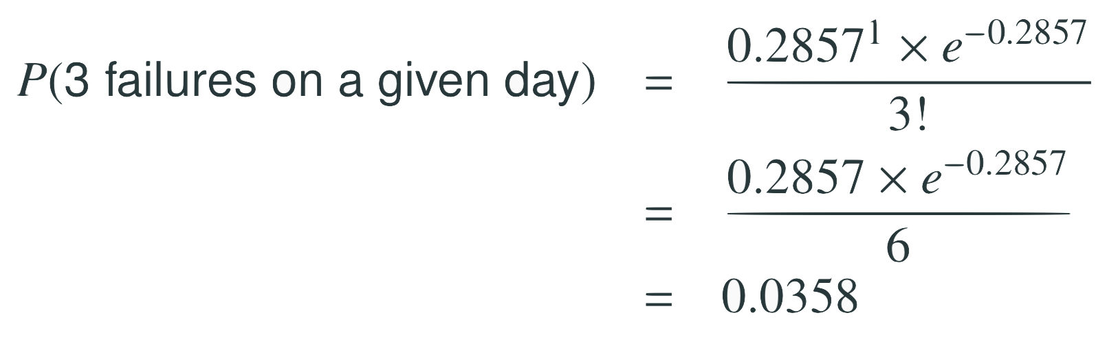
Example #2
Suppose that in a rural region of a developing country electricity power failures occur following a Poisson distribution with an average of 2 failures every week. Calculate the probability that on a given day the electricity fails three times.
We are given the weekly failure rate, but to answer this question
we need to first calculate the average rate of failure on a given day:
λ_{day} = 2 = 0.2857. Note that we are assuming that the probability 7
of power failure is the same on any day of the week, i.e. we assume independence.

Slide 12
Example #2
Suppose that in a rural region of a developing country electricity power failures occur following a Poisson distribution with an average of 2 failures every week. Calculate the probability that on a given day the electricity fails three times.
We are given the weekly failure rate, but to answer this question
we need to first calculate the average rate of failure on a given day:
λ_{day} = 2 = 0.2857. Note that we are assuming that the probability 7
of power failure is the same on any day of the week, i.e. we assume independence.

Slide 13
Example #2
Suppose that in a rural region of a developing country electricity power failures occur following a Poisson distribution with an average of 2 failures every week. Calculate the probability that on a given day the electricity fails three times.
We are given the weekly failure rate, but to answer this question
we need to first calculate the average rate of failure on a given day:
λ_{day} = 2 = 0.2857. Note that we are assuming that the probability 7
of power failure is the same on any day of the week, i.e. we assume independence.

Slide 14
Is it Poisson?
A random variable may follow a Poisson distribution if the event being considered is rare, the population is large, and the events occur independently of each other
However we can think of situations where the events are not really independent. For example, if we are interested in the probability of a certain number of weddings over one summer, we should take into consideration that weekends are more popular for weddings.
In this case, a Poisson model may sometimes still be reasonable if we allow it to have a different rate for different times; we could model the rate as higher on weekends than on weekdays.
The idea of modeling rates for a Poisson distribution against a second variable (day of the week) forms the foundation of some more advanced methods called generalized linear models. There are beyond the scope of this course, but we will discuss a foundation of linear models in Chapters 7 and 8.

Slide 15
Practice
A random variable that follows which of the following distributions can take on values other than positive integers?
(a) Poisson
(b) Negative binomial
(c) Binomial
(d) Normal
(e) Geometric

Slide 16
Practice
A random variable that follows which of the following distributions can take on values other than positive integers?
(a) Poisson
(b) Negative binomial
(c) Binomial
(d) Normal
(e) Geometric

